Slide 1
SCC211 Operation System
(Semaphores)
Zhang Jinyu – zjy@bjtu.edu.cn
School of Computer and Information Technology
SD408

Slide 2
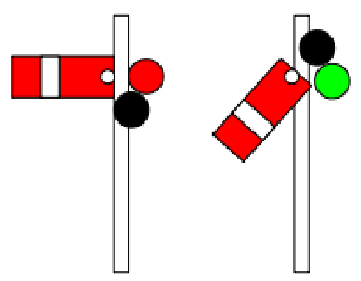
Objectives
Semaphore definition
Difference between locks and semaphores
Appropriate use of semaphores
Example: Producer/consumer

Slide 3
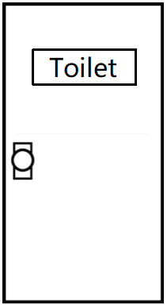

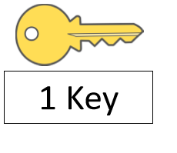
Example: Lock

Slide 4
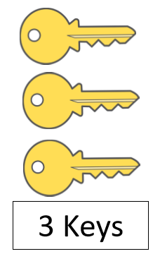
Example: Lock
Locks only provide mutual exclusion – One thread executes in the critical section at a time

Slide 5
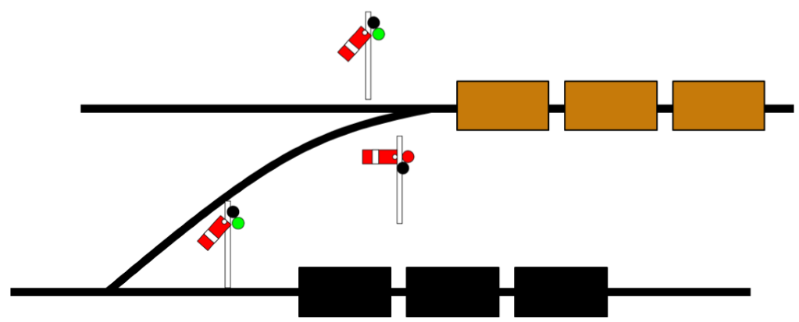
May want more threads or place ordering on thread scheduling
– Produce/consumer problem
– Need one program to run after the other
– Don’t wish to operate in lockstep

Slide 6
P() and V() – Wait and Signal
A synchronization primitive – Invented by computer scientists Edsget Dijkstra, 1965
Semaphores act similar to counters, and support two operations:
wait()
Decrement an internal counter by 1.
If the value is now negative, block the calling process.
P() or down()
acquire()
Increment counter by 1. If the pre-increment value was negative (i.e. processes waiting for a resource), transfer one blocked process to the run queue.
signal()
V() or up()
release()

Slide 7
Semaphore Psuedocode for Mutual Exclusion
Standard initial value of 1 is used for mutual exclusion
public class Bank_account {
private int bal = 0;
private Semaphore mutex = 1;
public void Bank_account(int start_balance)
{ bal = start_balance; }
public void update(int amount)
{
mutex.wait();
bal = bal + amount;
mutex.signal(); }
}
...
Bank_account b = new Bank_account(0);
‘Bracket’ critical section with wait() & signal() calls

Slide 8
How does this work?
1
Assume processes P1 and P2 arrive around the same time
(with P1 just ahead)
P1 calls wait() as semaphore is atomically decremented to 0;
P1 enters critical section without blocking
P2 attempts to enter critical section
wait() atomically decrements semaphore to negative value (-1) and blocks
P1 exits critical section; semaphore increments to 0 by P1 signal() call;
this P2 is unblocked
P2 enters the critical section
2
3
4
5

Slide 9
Semaphore Psuedocode for Mutual Exclusion
public class Bank_account {
private int bal = 0;
private Semaphore sem = 3;
public void Bank_account(int start_balance)
{ bal = start_balance; }
public void update(int amount)
{ sem.wait();
bal = bal + amount;
sem.signal(); }
}
...
Bank_account b = new Bank_account(0);
Can now allow 3 threads to execute in critical section
‘Bracket’ critical section with wait() & signal() calls
X
Must be atomic
Three threads reading/writing shared resource will introduce non-determinism

Slide 10
Implementing Semaphores
Each semaphore has an associated queue for processes
When wait() is called by the thread:
If semaphore open, thread continues
If semaphore closed, thread blocks onto queue
Then signal() opens the semaphore
If thread is waiting on queue, thread unblocked
If no threads on queue, signal remembered for next thread
The scheduler maintains a queue or processes Run queue and blocked queue (per semaphore)
维护运行队列和阻塞队列

Slide 11
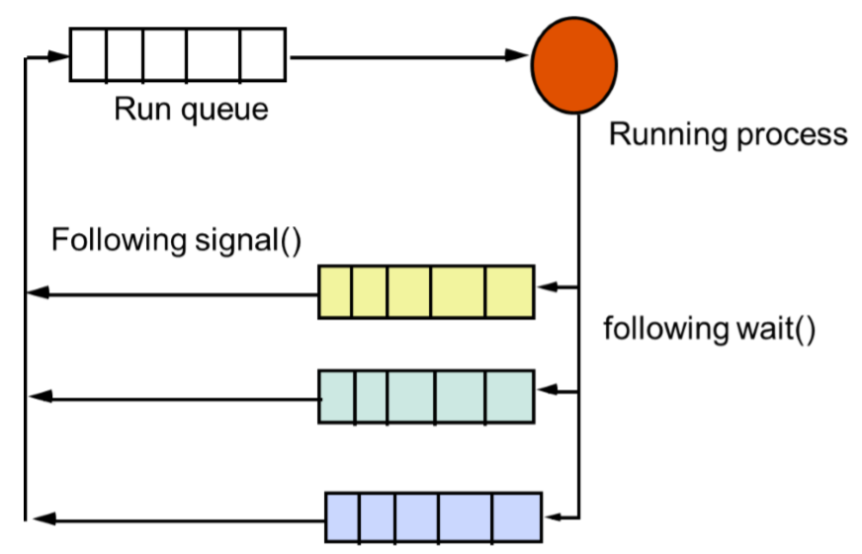
Semaphores and Scheduler (Uniprocessor)
Semaphore queues-one per semaphore

Slide 12
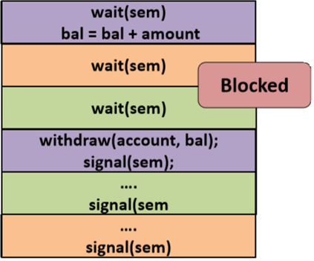
Queue Example
typedef struct _sem{ int val;
Queue *queue;
} Sem
deposit (int amount){
wait(Sem);
bal = bal + amount;
withdraw(account, bal);
signal(Sem);
send_msg_cust(time, “Completed.”);
}
Unknown which thread runs after signal
Thread 1
Thread 2
Thread 3

Slide 13
Implementation in Traditonal Unix Kernel
This implementation builds on two lower-level intra-kernel process synchronization primitives
sleep(int i);
Block the calling process by placing it on a queue
i is an arbritary designator used for sleep calls
wakeup(int i);
Put all the processes that sleep(i) called onto the run queue
If no such process, do nothing (potential lost wakeup problem)
i :进程id
传统的Unix内核是非抢占的，不需要额外的互斥来使wait()和signal()原子化!
The traditional Unix kernel is non-preemptible, no need for additional mutual exclusion to make wait() and signal() atomic!

Slide 14
Semaphore impl. w/ Unix sleep() and wakeup()
typedef struct _sem {
int val; /* semaphore value*/
Queue *queue; /* oper: put, get*/
} Sem
void P(Sem *s) { /* wait() procedure */
s->val = s->val - 1;
if (s->val < 0) {
put(s->queue, getpid()); /* queue of PIDs */
sleep(getpid()); } }
void V(Sem *s) { /*signal() procedure */
s->val = s->val + 1;
if (s->val <= 0){
wakeup(get(s->queue));} }
Declare semaphore class
If full, put threads on queue
Sleep threads on queue
Wake up threads on queue

Slide 15
Semaphores in Java
Example how semaphores could be implemented
As an alternative concurrent management to synchronized, can build on Java facilities analogous to sleep() / wakeup()
As well as intrinsic lock (synchronized), each Java object has an intrinsic wait queue
Object.wait()
Suspend the called thread and place it on target object’s wait queue;
Release the object lock on the target, let caller retain any other locks
Object.notify()
If exists, take thread(s) from object wait queue and make it runnable
Must obtain target’s object lock before resuming
May only be used inside synchronized blocks

Slide 16
Semaphores in Java
public class Semaphore {
private int count = 0;
public Semaphore(int init_val) {
count = init_val; // Should check it’s >= 0
}
public synchronized void P() {
count = count - 1;
if (count < 0) wait(); // Go on per-object queue
}
public synchronized void V() {
count = count + 1;
if (count <= 0) notify(); // Free a waiting thread
}
}

Slide 17
Semaphores in Java
public class Semaphore {
private int count = 0;
public Semaphore(int init_val) {
count = init_val; // Should check it’s >= 0
}
public synchronized void P() {
count = count - 1;
while (count < 0) wait(); //why not ‘if’?
}
public synchronized void V() {
count = count + 1; /* if there is one, wake a waiter;
notifyAll(); /*why not use ‘notify()’? */
}
}

Slide 18
notify() and notifyAll()
Tell one waiting thread or tell all threads?
Example, set of threads waiting for a certain task to finish.
Once task finishes, all waiting threads can continue
In such a case you would use notifyAll() to wake all waiting threads
Mutually exclusive locking, only one waiting threads can do something useful after notification (i.e. acquire the lock).
You would rather use notify()
You could use notifyAll() but you would unnecessarily wake threads that can't do anything anyway
Be aware of spurious wakeup
(accidently wake up all threads you don’t mean to)

Slide 19
Spurious Wakeup
一个虚假的唤醒
public class Semaphore {
private int count = 0;
public Semaphore(int init_val){
count = init_val; }
public synchronized void P() {
count = count - 1;
if (count < 0) wait(); }
public synchronized void V() {
count = count + 1;
notifyAll();
}
}
Thread 1
Thread 2
Thread 3
Does not recheck the condition
对于不应该被唤醒的线程而言，便是虚假唤醒

Slide 20
User Defined Box Sizing
– One process reads a number from keyboard and places inside an object of class BoxDimension
– Separate process extracts the number from BoxDimension object, and draws a box of corresponding size

Slide 21
Programming
public class BoxDimension{
private int dim = 0;
public void put(int d)
{dim = d; }
public int get() { return dim; }
}
BoxDimension d = new BoxDimension();
Process Putter
Process Getter

Slide 22
Programming
public class BoxDimension{
private int dim = 0;
private Semaphore sem = 1;
public void put(int d)
{dim = d;
sem.signal();
}
public int get()
{ sem.wait();
return dim; }
}
BoxDimension d = new BoxDimension();
Process Putter
Process Getter

Slide 23
Producer-Consumer Problem
Consumer cannot take a non-existent element!
Create a buffer between components
Can use arrays, lists, etc. Increment/decrement buffer
If full, block producer – If empty, block consumer

Slide 24
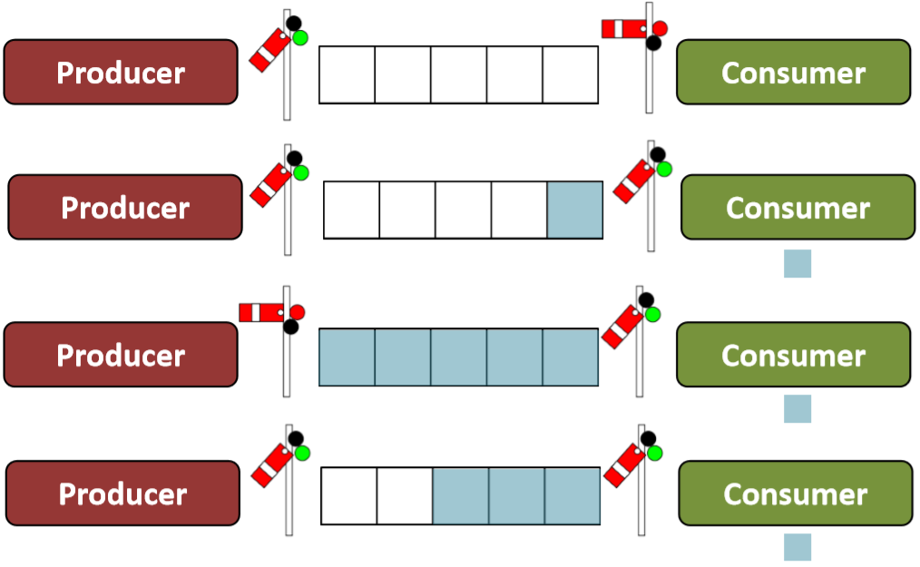
Producer Consumer Problem

Slide 25
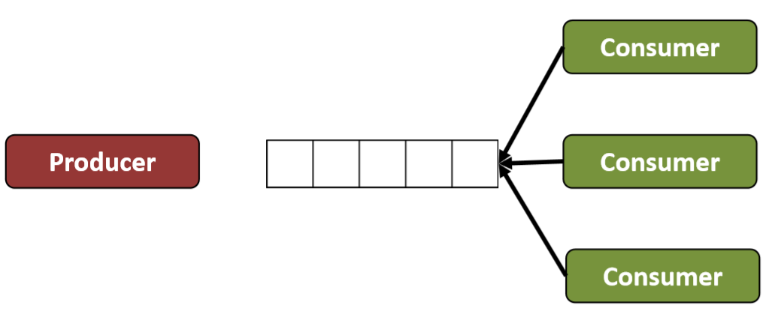

Slide 26
Summary
– Semaphores area common type of exclusion lock
– They work for condition synchronizations as well
– Semaphore implementations typically closely tied to underlying scheduler
– Semaphores can be implemented in a number of ways
– On top of lower-level primitives such as Unix sleep/wakeup, or Java wait/notify/notifyAll

Slide 27
Question？

